Slide 1
Bolter Slug
N315 – Project Three
Jake Terry
https://github.com/jaketerry28/CS315-Game-Programming/tree/main/final-project
https://jaketerry28.itch.io/bolt-slug

Slide 2
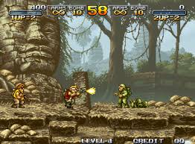
Discussion 0
Inspiration from Metal Slug

Slide 3
Discussion 0.1
Review some game sites on itch.io
Make your own itch account
Create a page for your game – you can keep it private for now
Think about the graphics, text, and decorations you will need on your itch page

Slide 4
Discussion 0.2
Talk with a peer about the following, delete and add a summary of your reflection:
  Core gameplay systems
  How those systems are interaction loops
  What kinds of feedback are needed for players to understand the systems
    Visual ( animation, particles )
    Audio
    Haptic
  Look for 1-2 extra learning resources for your game

Slide 5
Discussion 0.3
Write some extra code and check it into Github
Link that Github commit here

Slide 6
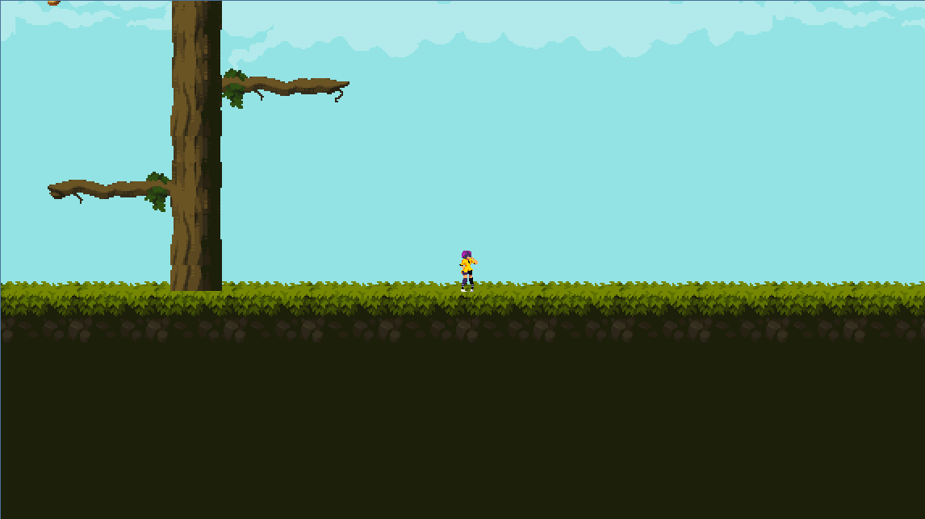
Discussion 1

Slide 7
Discussion 1 – Progress
By now you should have:
Basic interactions programmed (movement, selection.. Whatever)
Basic program structure implemented
Some placeholder assets in the game

Slide 8
Discussion 1 – Screenshot / image

Slide 9
Discussion 1 – Question about your game

Slide 10
Discussion 1 –Aesthetics & Meaning
Delete this and add 2-3 takeaways from your discussion with your peer
How does your game “read” (what is understandable from gameplay)
What might be missing from the current feel that could be adjusted with timing or graphical changes
What mid and long term player goals could better contextualize these player actions?

Slide 11
Discussion 1 – Meaning Reflection
Delete and add your own reflection ( How are you progressing in your technique? What about your programming process needs to change? )

Slide 12
Discussion 2 –Aesthetics and Meaning

Slide 13
Discussion 2 – Progress
By now you should have
  Interactable / extended systems coded
  Bugs in implementation
  A playable game loop with end state

Slide 14
Discussion 2 – Screenshot / Image

Slide 15
Discussion 2 –Question about your game

Slide 16
Discussion 2
Discuss and reflect upon these aspects of your game with a peer
  Purpose
  Sincerity
  Expressiveness
How might important features of the loop be emphasized?
How do the bugs you current have (or encountered) offer learning opportunities for you?

Slide 17
Discussion 2 –Reflection
Delete and add your own reflection ( What does it mean to create a meaningful game? Is it different than a fun game? How important is programming to the above aspects?)

Slide 18
P3 – Final Reflection
Screenshot of final product here

Slide 19
P3 – Final Reflection
What might other individuals learn from the struggles you overcame in this project?
What have you learned about the interaction of your game system with the player experience
  When are they the same? When are they not? How do they influence and affect each other?
Something funny.

